Slide 1
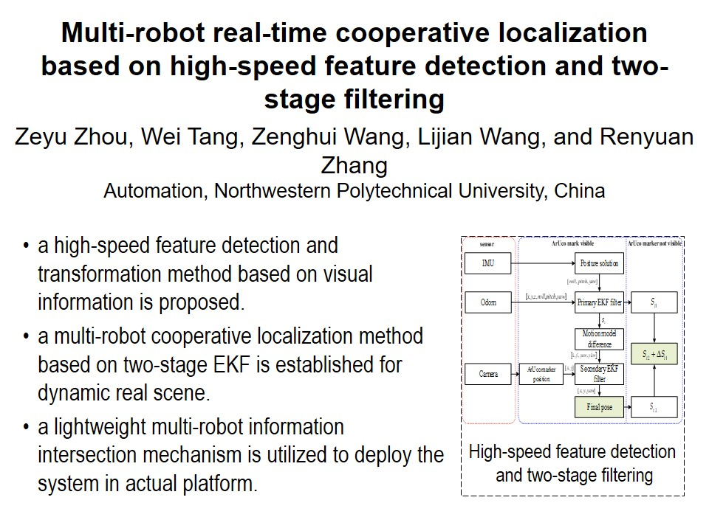
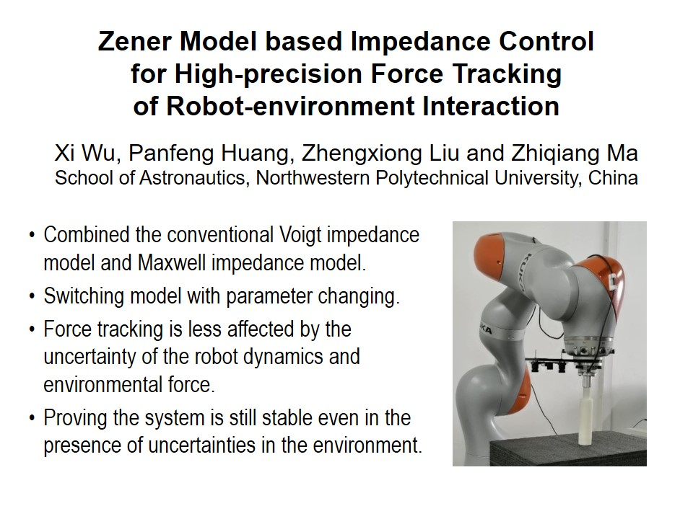
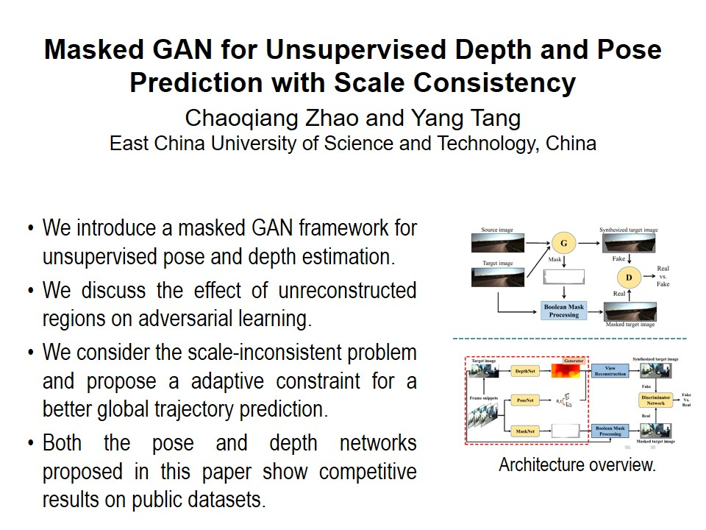
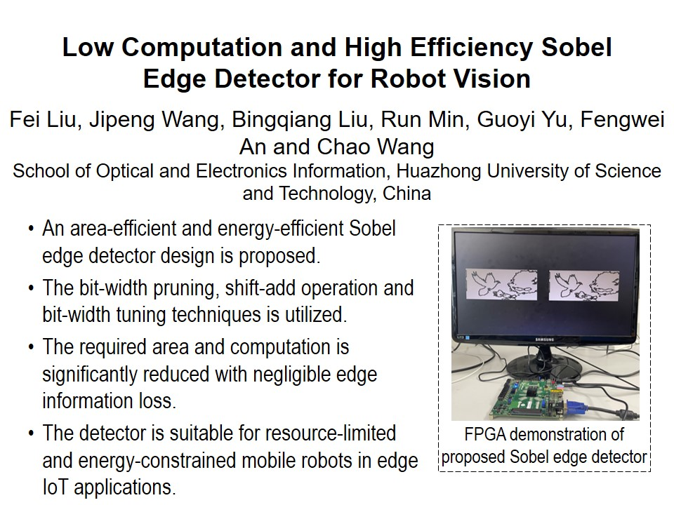
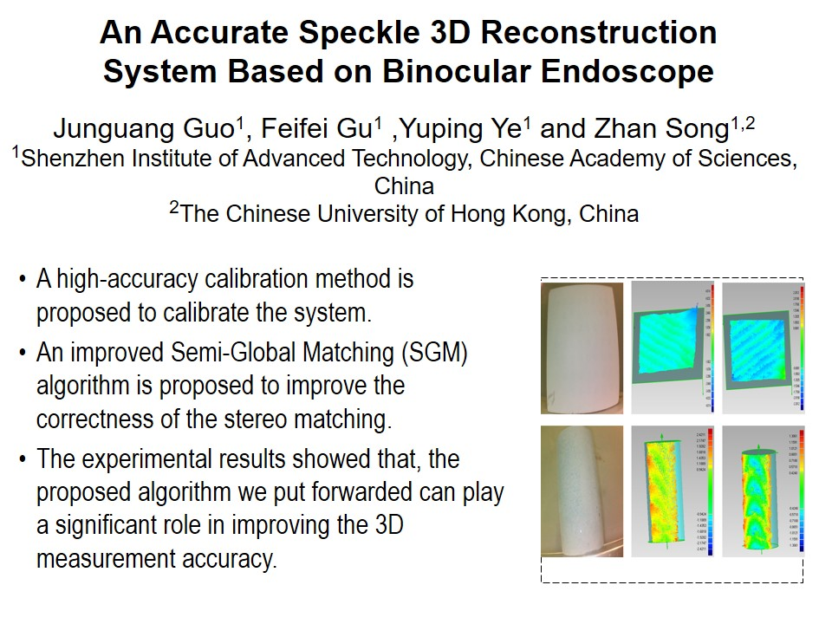
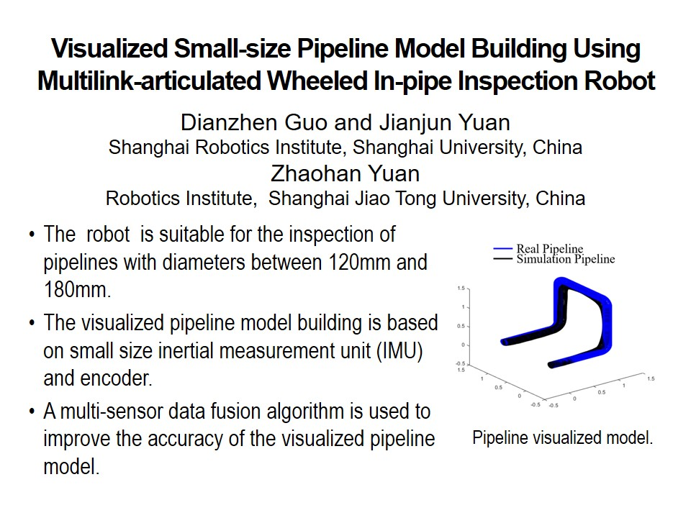
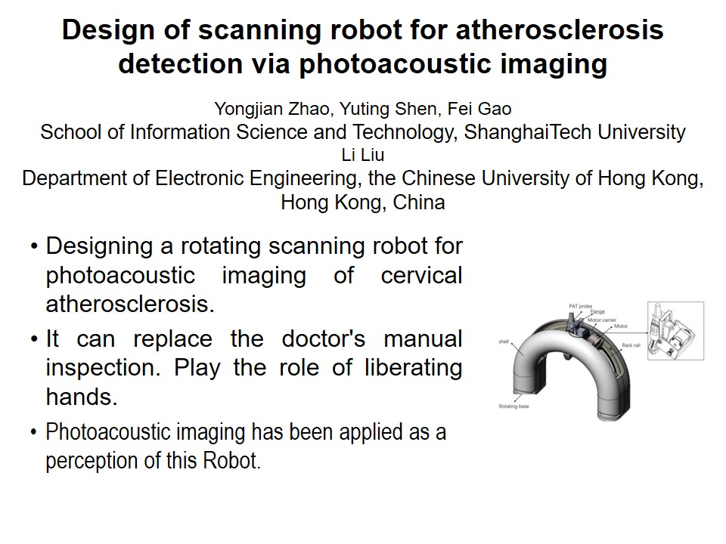
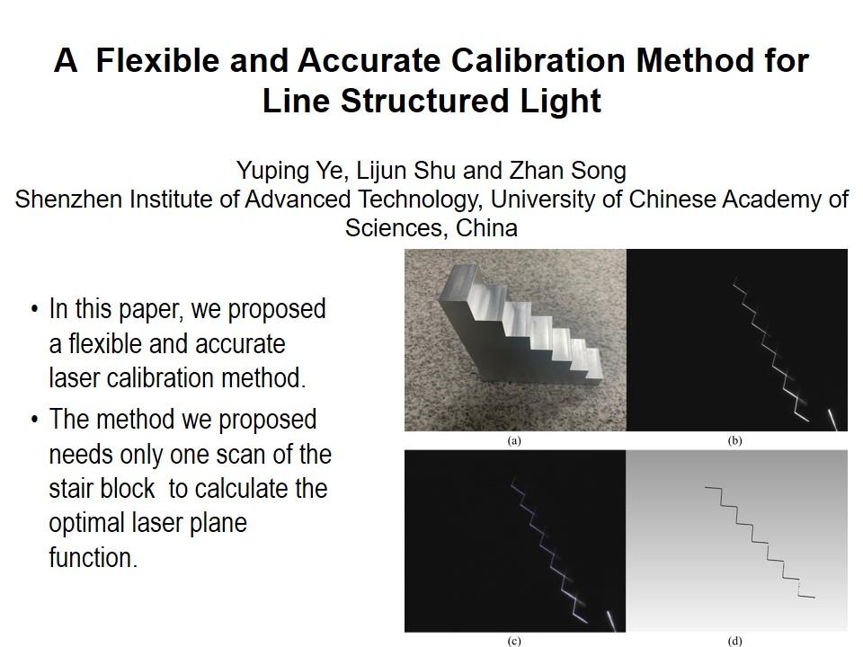
RCAR2021 Technical Sessions
FE6:Grasping stragety
Session Chair:Hong xinshi and Legend
Metting room1:July 15, 14:00-15:45, Friday
FE6-1, 14:00-15:45
FE6-1, 14:00-15:45
FE6-1, 14:00-15:45
FE6-1, 14:00-15:45
FE6-1, 14:00-15:45
FE6-1, 14:00-15:45
FE6-1, 14:00-15:45
FE6-1, 14:00-15:45

Slide 2
RCAR2021 Technical Sessions
FE6:Grasping stragety
Session Chair:Hong xinshi and Legend
Metting room1:July 15, 14:00-15:45, Friday
FE6-1, 14:00-15:45
FE6-1, 14:00-15:45
FE6-1, 14:00-15:45
FE6-1, 14:00-15:45
FE6-1, 14:00-15:45
FE6-1, 14:00-15:45

Slide 3
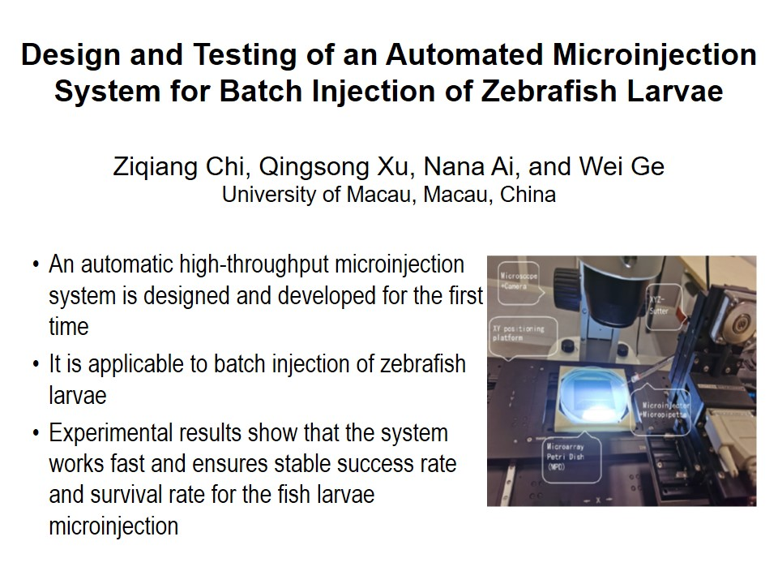
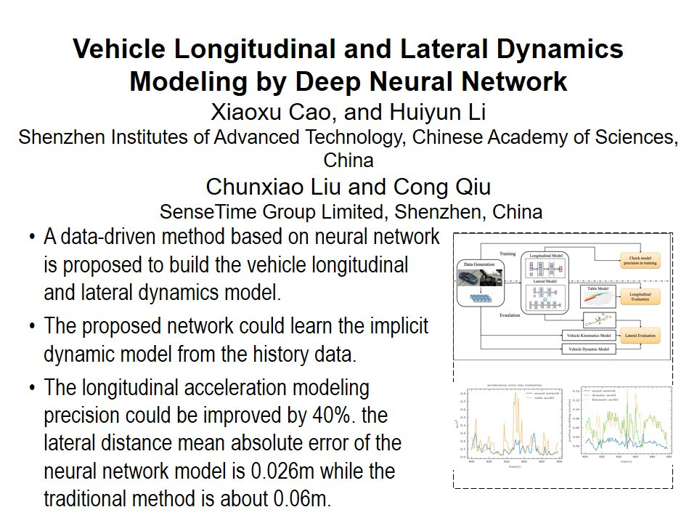
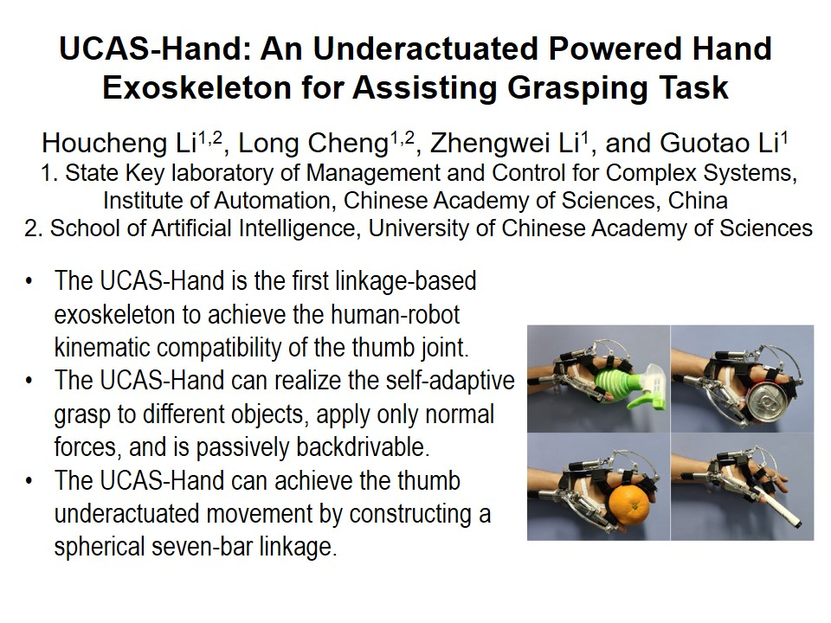

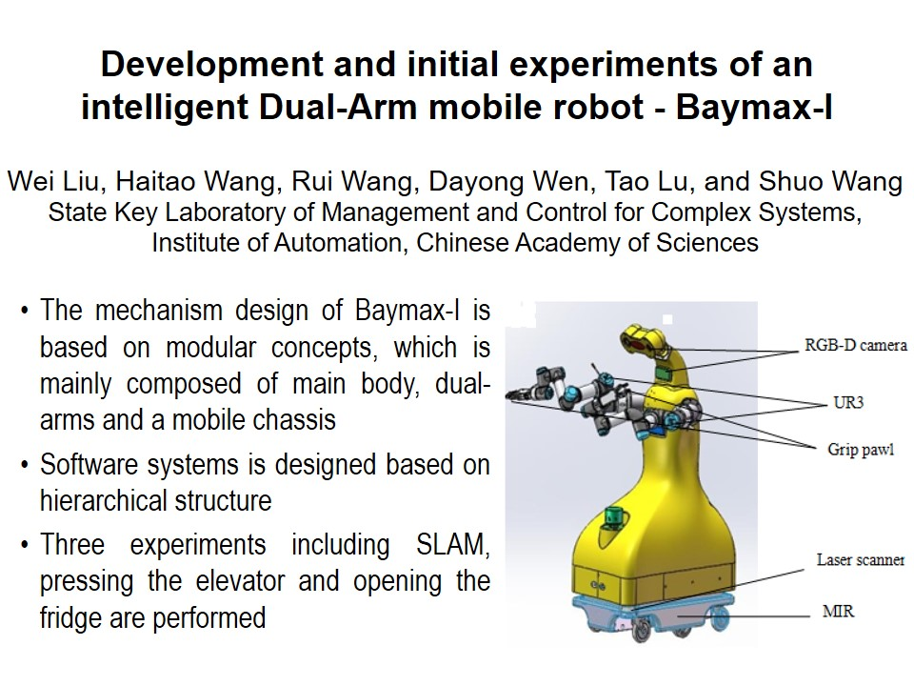
RCAR2021 Technical Sessions
SaA I:Best Paper
Session Chair:
Jingya Pavilion : July 15, 14:00 - 15:45, Saturday
14:00~14:15
14:15~14:30
14:30~14:45
14:45~15:00
15:00~15:15
T1

Slide 4
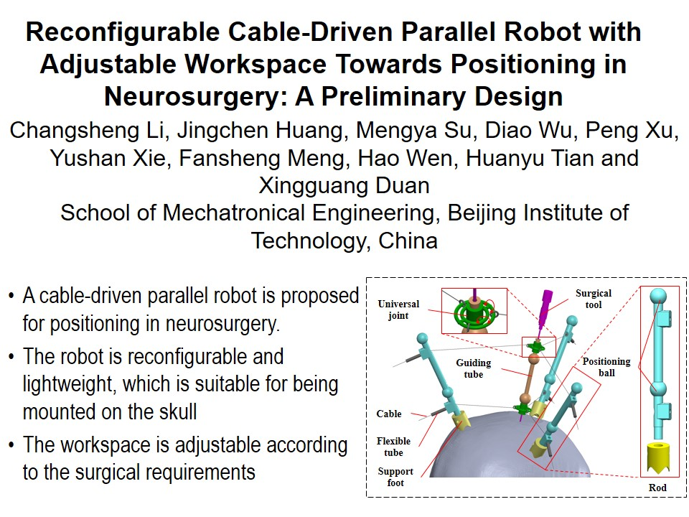

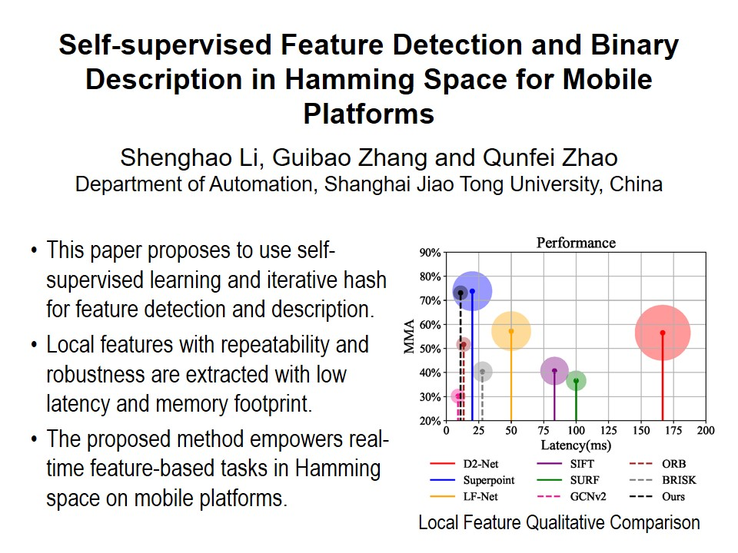
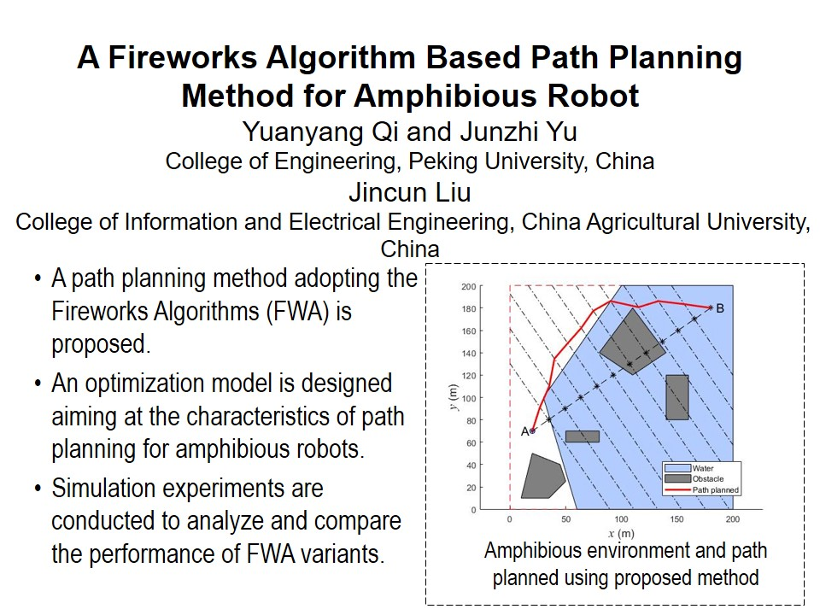
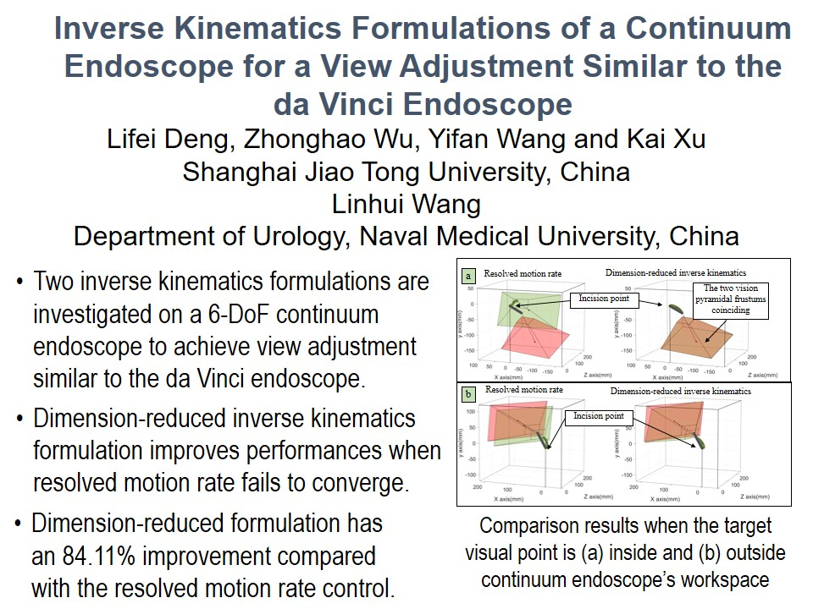
RCAR2021 Technical Sessions
SaB I:Best Paper In Robotics
Session Chair:
Lanting Pavilion : July 15, 14:00 - 15:45, Saturday
14:00~14:15
14:15~14:30
14:30~14:45
14:45~15:00
15:00~15:15
T2

Slide 5
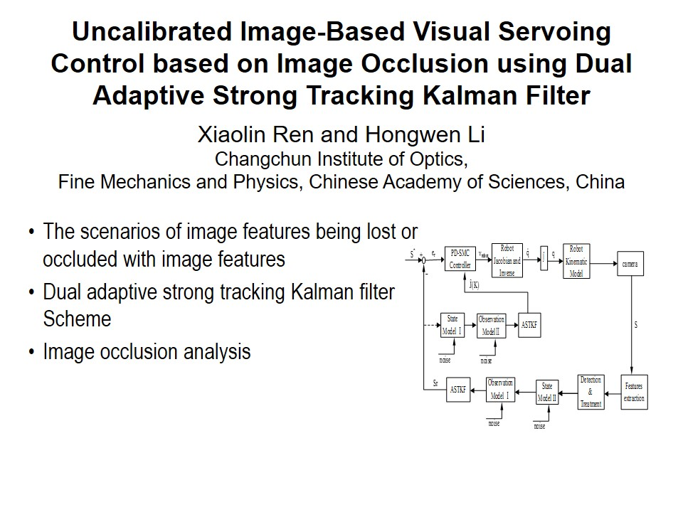
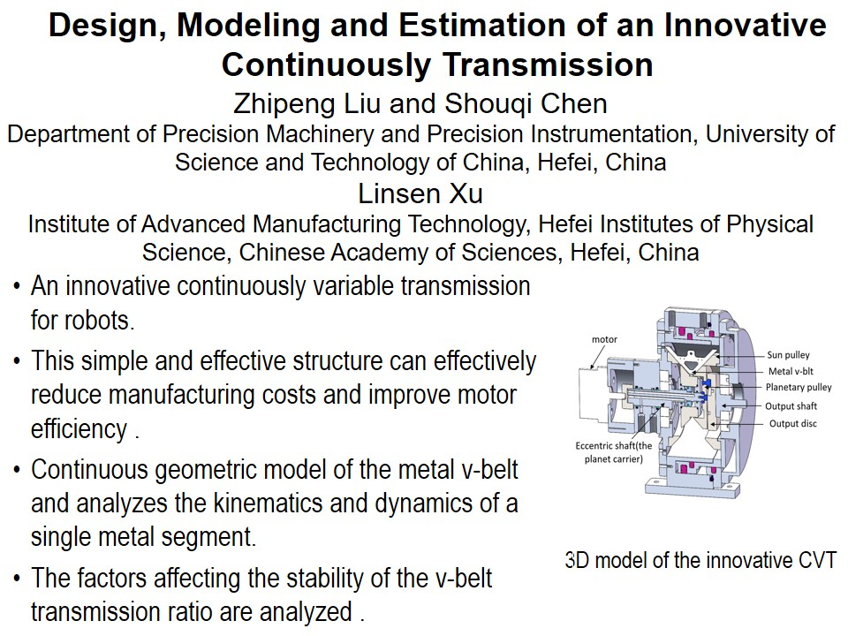
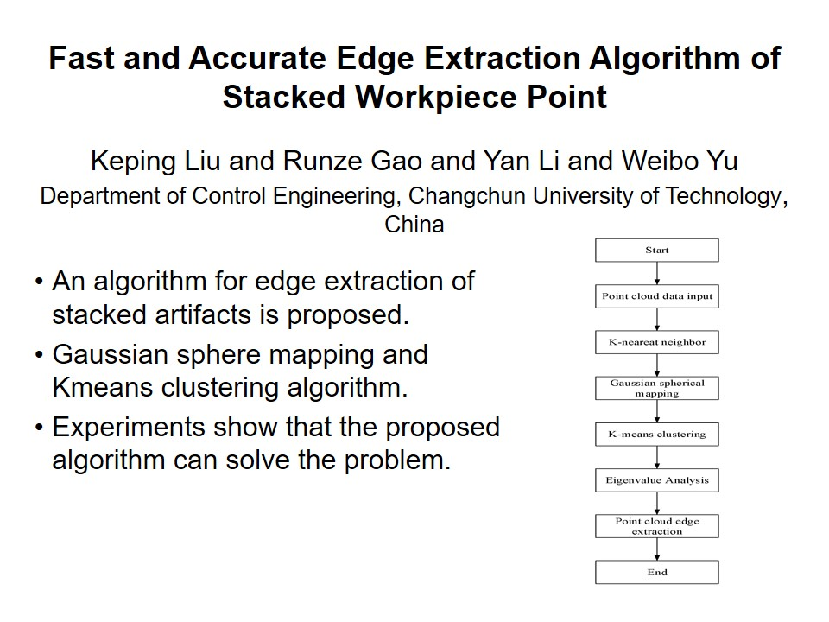
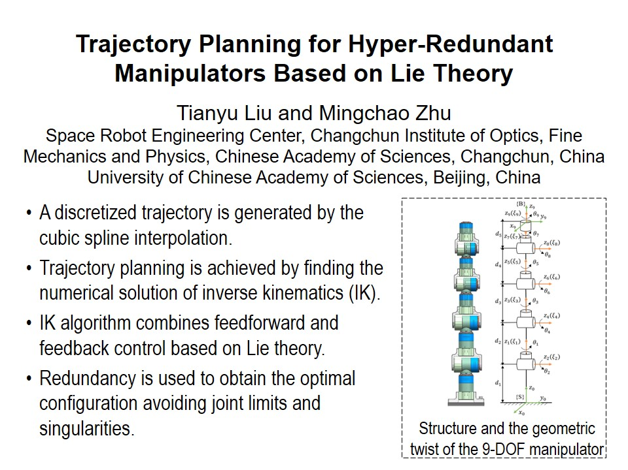
RCAR2021 Technical Sessions
SaC I:Computational intelligence in robotics Ⅰ
Session Chair:
Meeting Room 1 : July 15, 14:00 - 15:45, Saturday
14:00~14:15
14:15~14:30
14:30~14:45
14:45~15:00
T3

Slide 6
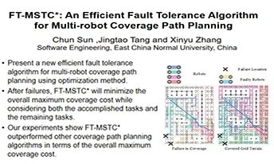
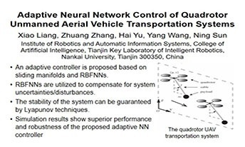
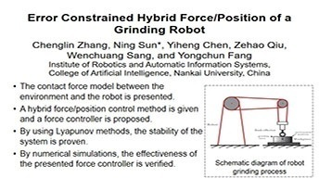
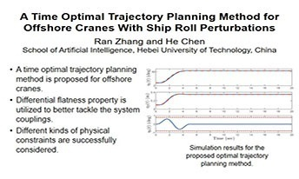
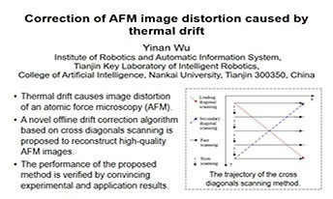
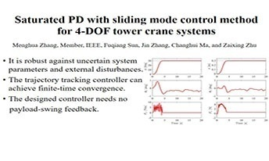
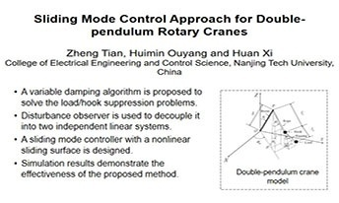
RCAR2021 Technical Sessions
SaD I:Motion control of robotic systems
Session Chair:
Meeting Room 2 : July 15, 14:00 - 15:45, Saturday
14:00~14:15
14:15~14:30
14:30~14:45
14:45~15:00
15:00~15:15
15:15~15:30
15:30~15:45
T4

Slide 7
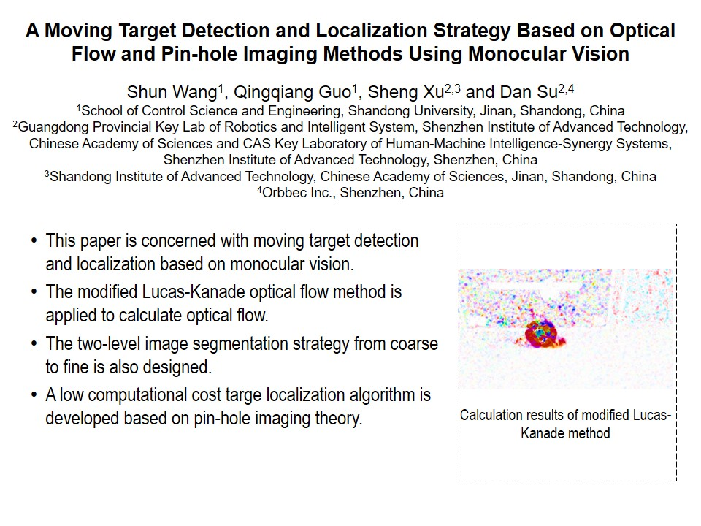
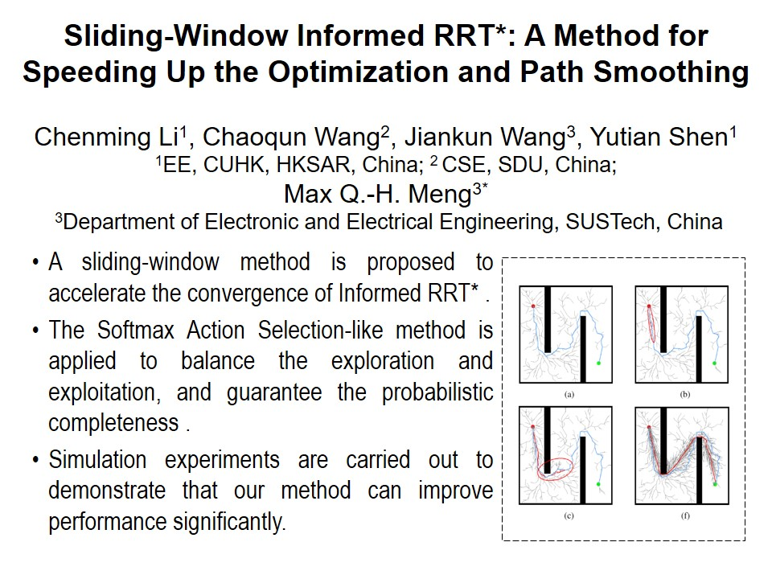
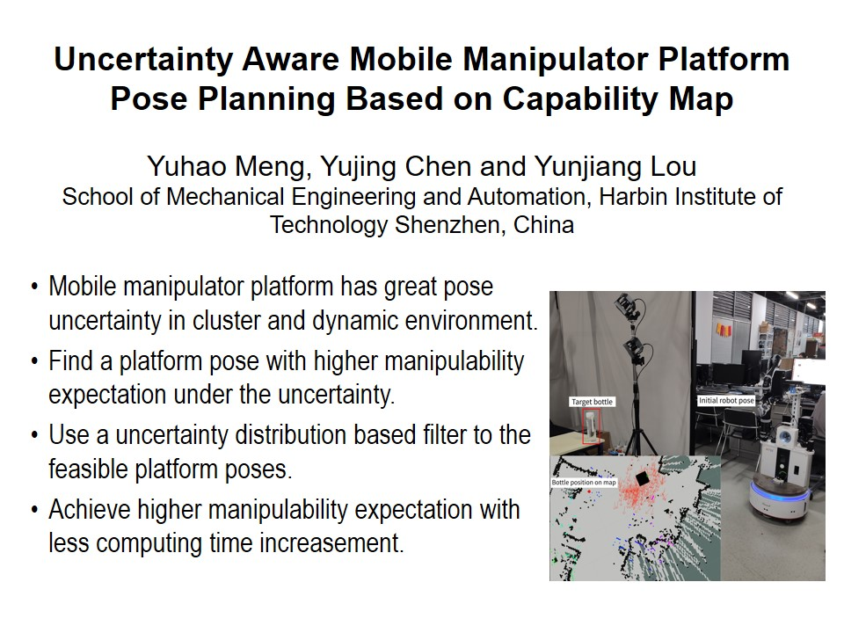
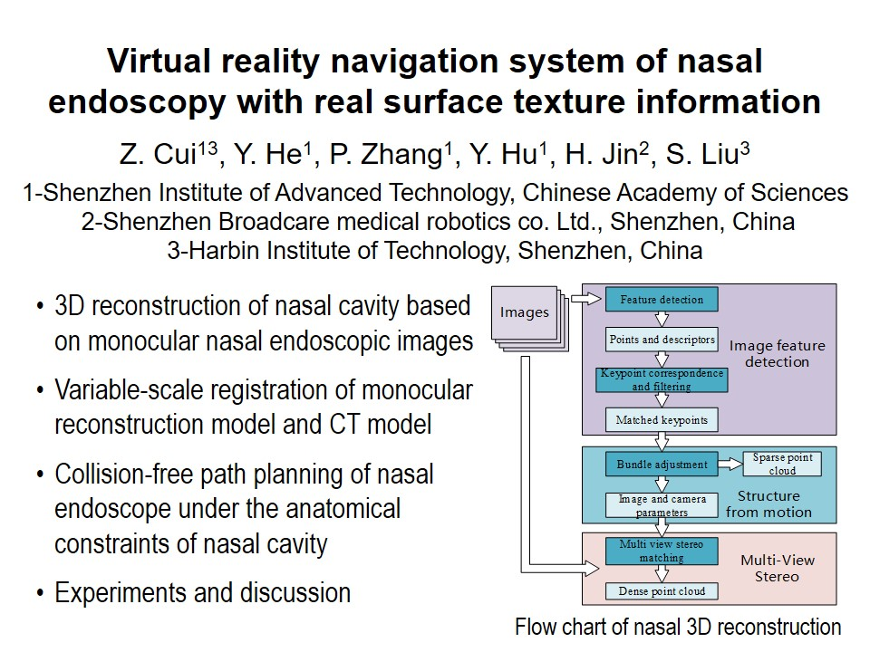
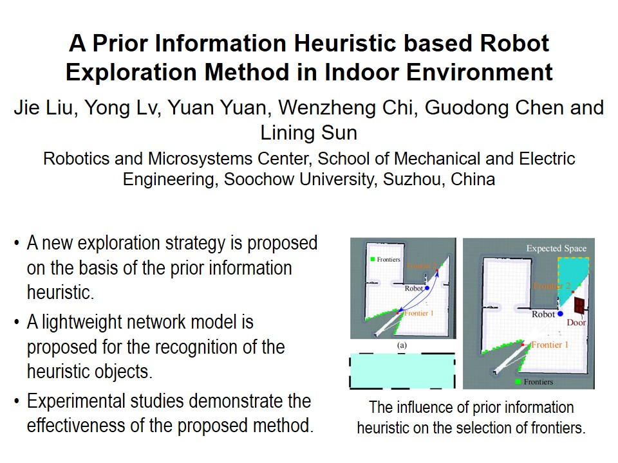
RCAR2021 Technical Sessions
SaA Ⅱ:Best Student Paper
Session Chair:
Jingya Pavilion : July 15, 16:15 - 18:00, Saturday
16:15~16:30
16:30~16:45
16:45~17:00
17:00~17:15
17:15~17:30
T5

Slide 8
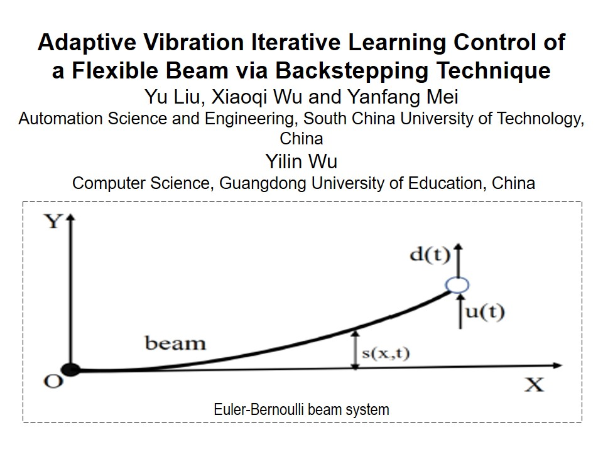
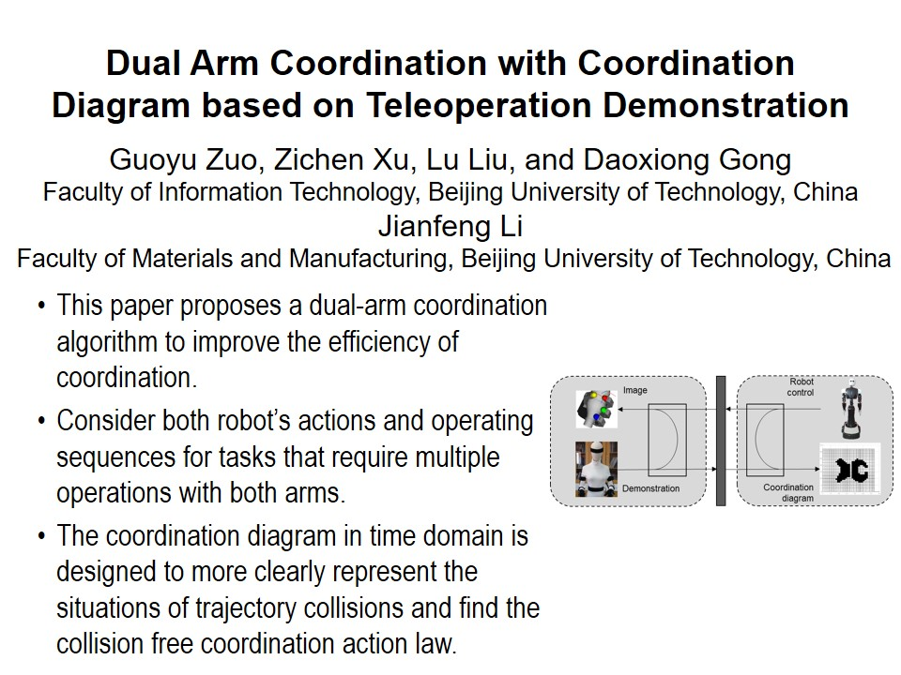
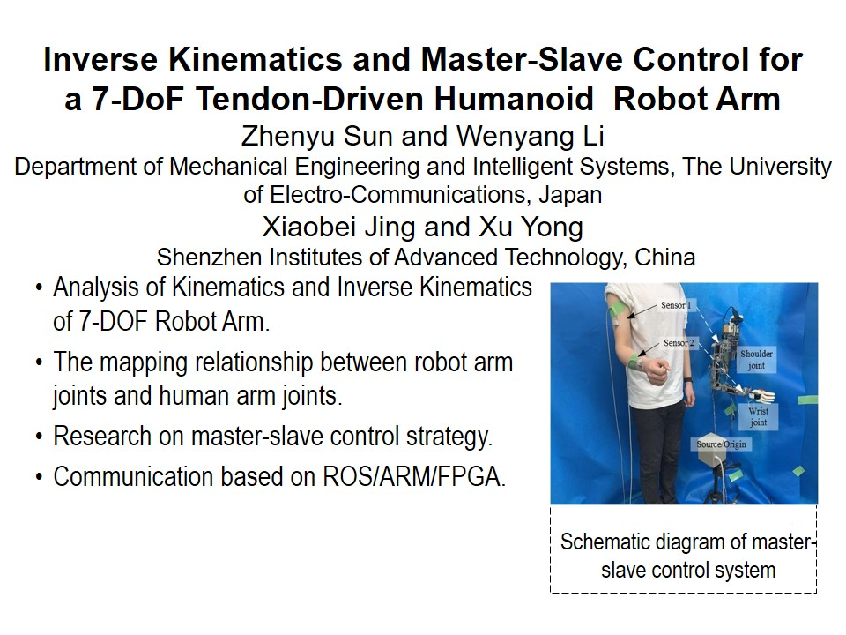
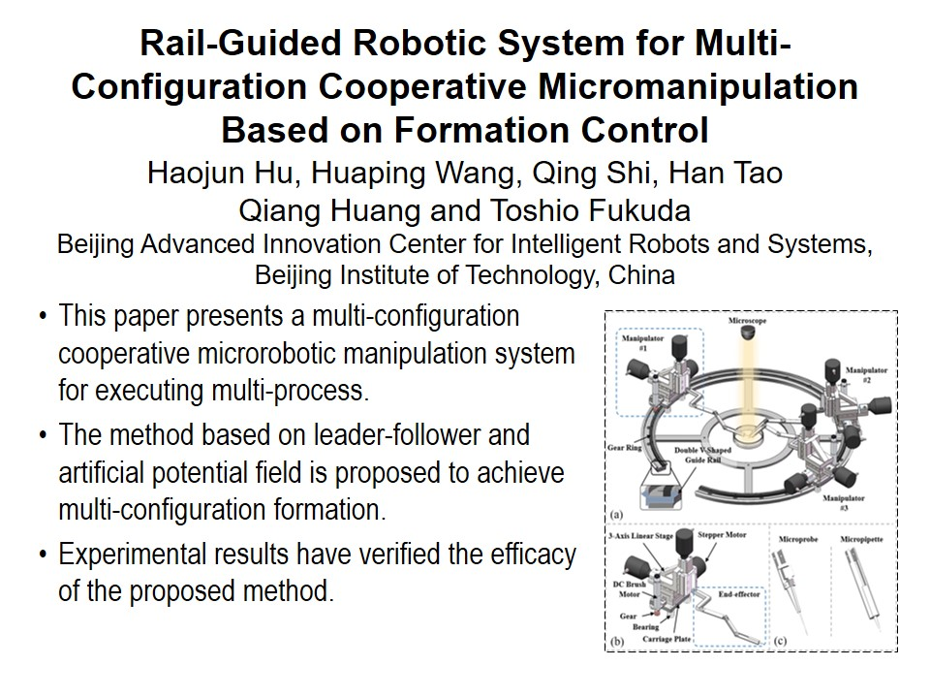
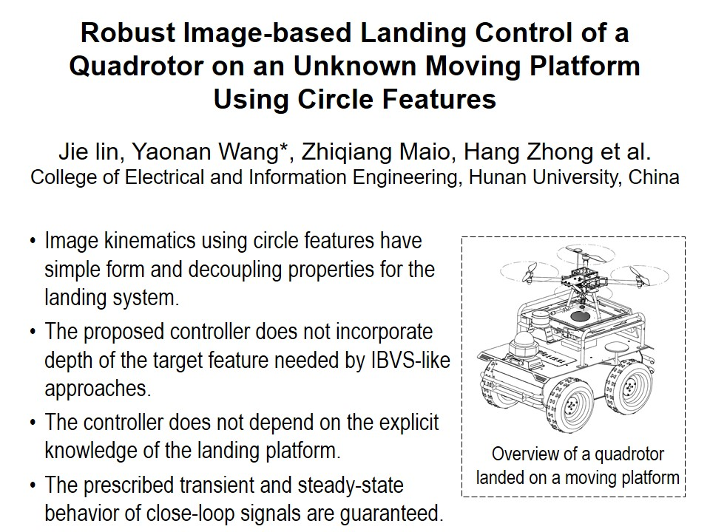
RCAR2021 Technical Sessions
SaB Ⅱ:Best Paper In Control
Session Chair:
Lanting Pavilion : July 15, 16:15 - 18:00, Saturday
16:15~16:30
16:30~16:45
16:45~17:00
17:00~17:15
17:15~17:30
T6

Slide 9
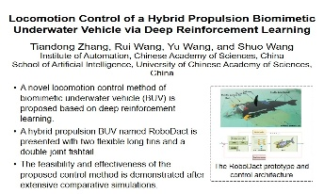
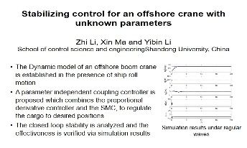
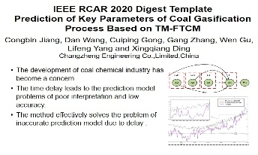
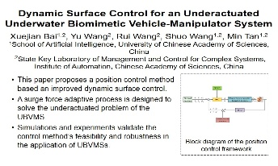
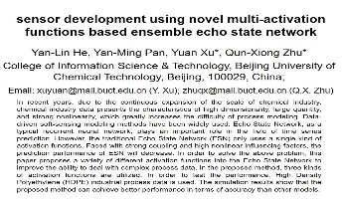
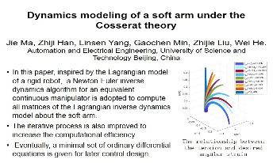
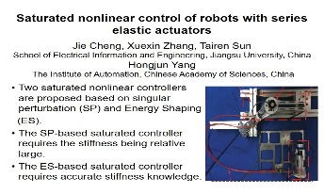
RCAR2021 Technical Sessions
SaC Ⅱ:Robotic Control I
Session Chair:
Meeting Room 1 : July 15, 16:15 - 18:00, Saturday
16:15~16:30
16:30~16:45
16:45~17:00
17:00~17:15
17:15~17:30
17:30~17:45
17:45~18:00
T7

Slide 10
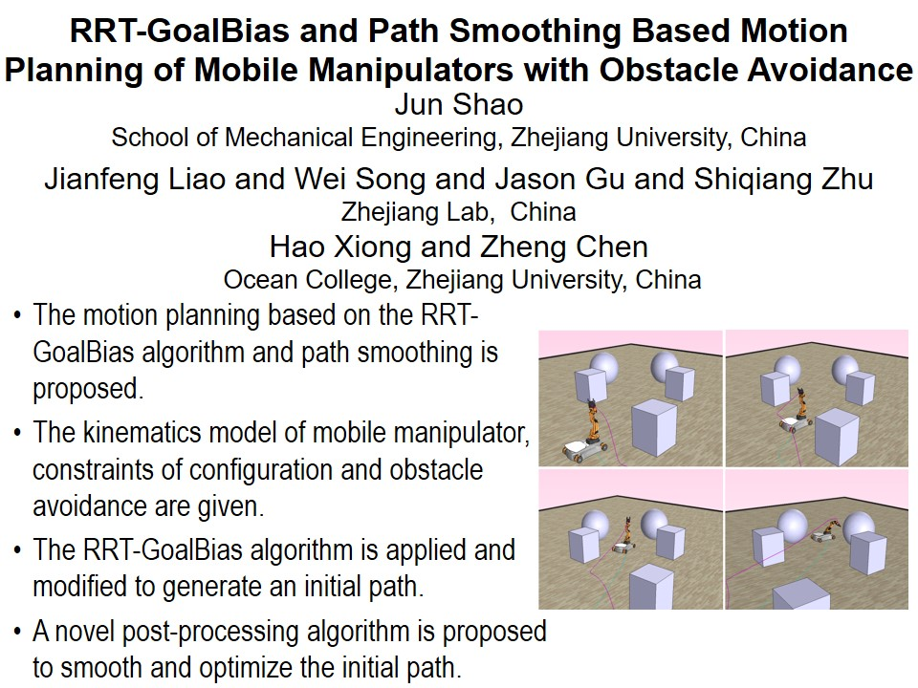
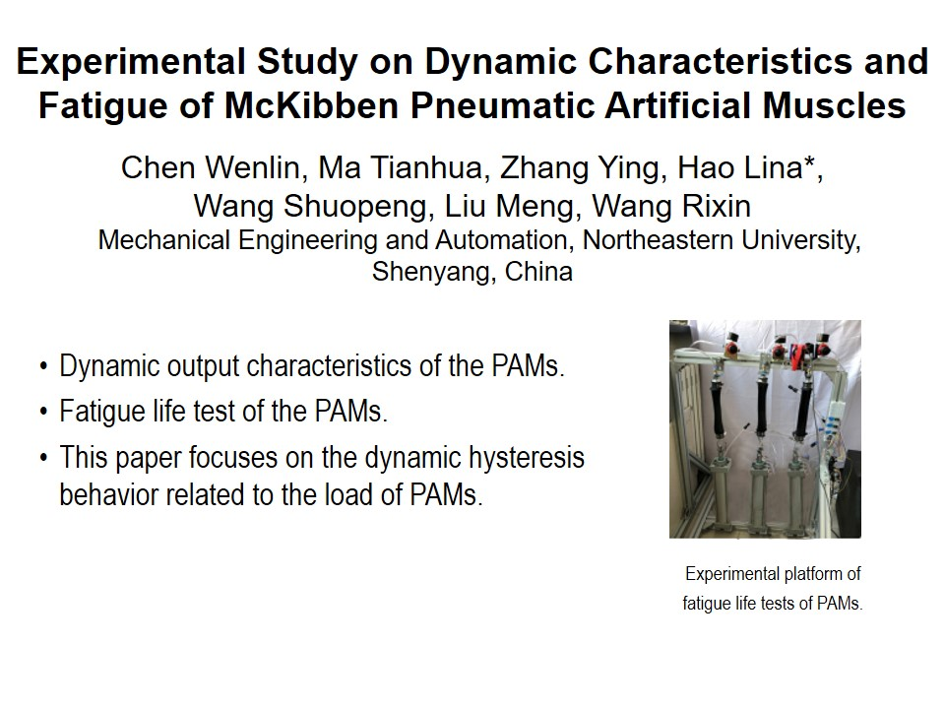
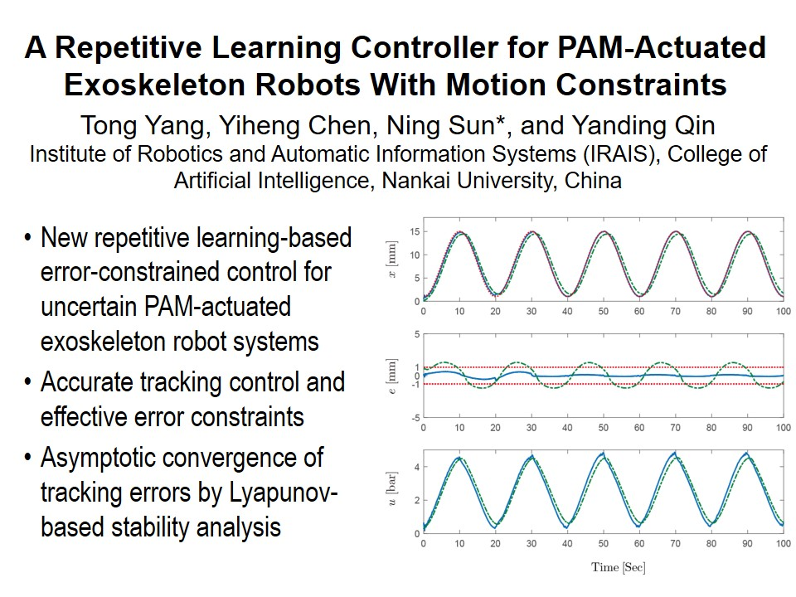
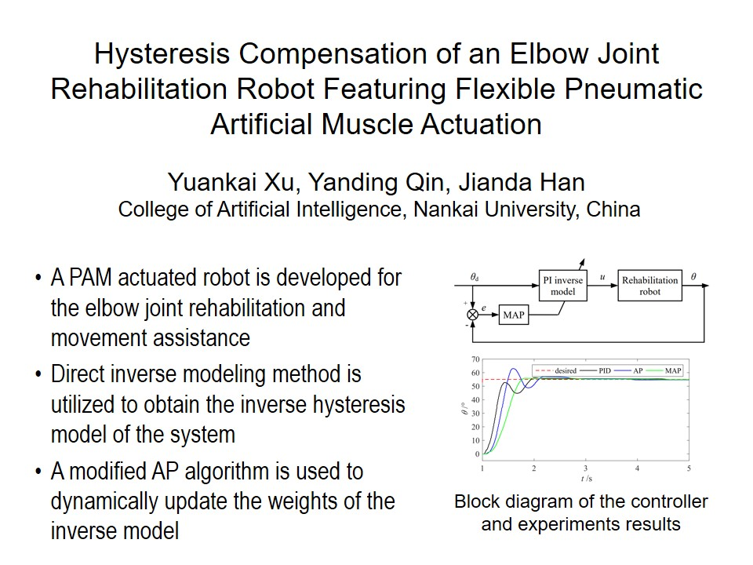
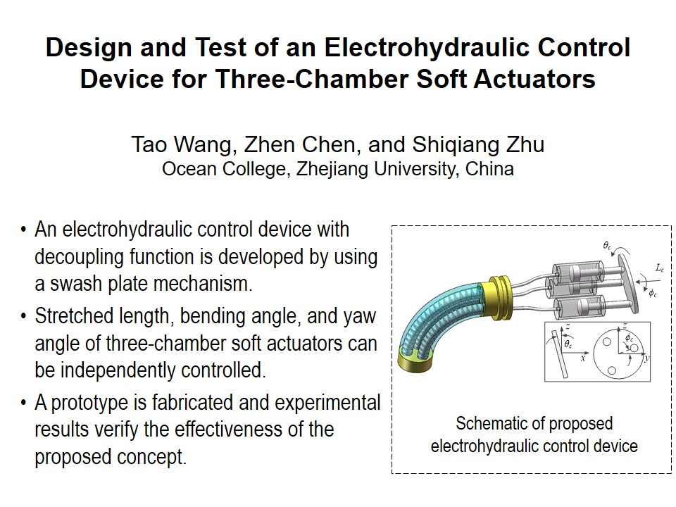
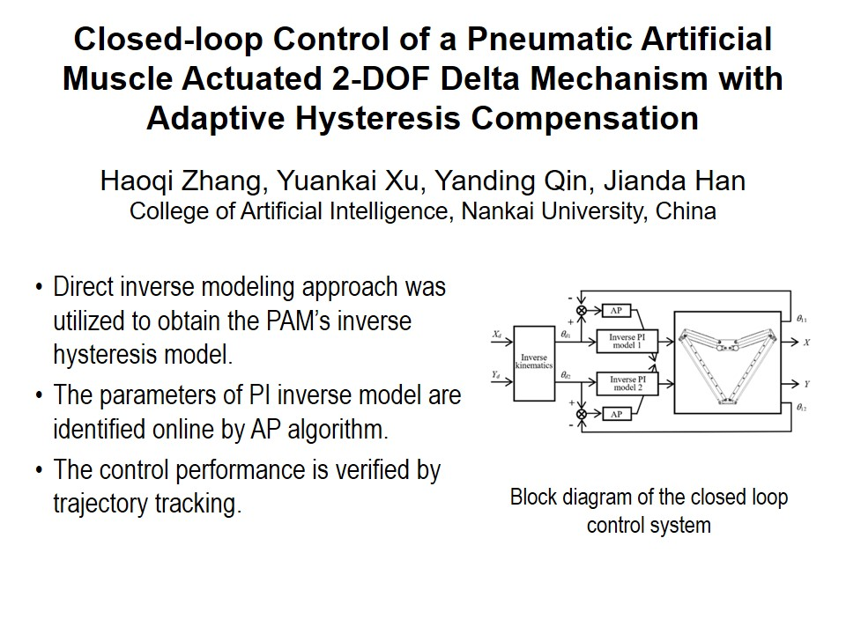
RCAR2021 Technical Sessions
SaD Ⅱ:Design and control of pneumatic and soft robotic system
Session Chair:
Meeting Room 2 : July 15, 16:15 - 18:00, Saturday
16:15~16:30
16:30~16:45
16:45~17:00
17:00~17:15
17:15~17:30
17:30~17:45
T8

Slide 11








RCAR2021 Technical Sessions
SuA I:Sensing technology and recognition
Session Chair:
Jingya Pavilion : July 16, 14:00 - 15:45, Sunday
14:00~14:15
14:15~14:30
14:30~14:45
14:45~15:00
15:00~15:15
15:15~15:30
15:30~15:45
15:45~16:00
T9

Slide 12







RCAR2021 Technical Sessions
SuB I:Advances in Human-Machine Interface and Intelligent Interactions I
Session Chair:
Lanting Pavilion : July 16, 14:00 - 15:45, Sunday
14:00~14:15
14:15~14:30
14:30~14:45
14:45~15:00
15:00~15:15
15:15~15:30
15:30~15:45
T10

Slide 13







RCAR2021 Technical Sessions
SuC I:Robot Mechanism I
Session Chair:
Meeting Room 1 : July 16, 14:00 - 15:45, Sunday
14:00~14:15
14:15~14:30
14:30~14:45
14:45~15:00
15:00~15:15
15:15~15:30
15:30~15:45
T11

Slide 14







RCAR2021 Technical Sessions
SuD I:Vision I
Session Chair:
Meeting Room 2 : July 16, 14:00 - 15:45, Sunday
14:00~14:15
14:15~14:30
14:30~14:45
14:45~15:00
15:00~15:15
15:15~15:30
15:30~15:45
T12

Slide 15







RCAR2021 Technical Sessions
SuA Ⅱ:Mobile Robots I
Session Chair:
Jingya Pavilion : July 16, 16:15 - 18:00, Sunday
16:15~16:30
16:30~16:45
16:45~17:00
17:00~17:15
17:15~17:30
17:30~17:45
17:45~18:00
T13

Slide 16





RCAR2021 Technical Sessions
SuB Ⅱ:Advances in Human-Machine Interface and Intelligent Interactions II
Session Chair:
Lanting Pavilion : July 16, 16:15 - 18:00, Sunday
16:15~16:30
16:30~16:45
16:45~17:00
17:00~17:15
17:15~17:30
T14

Slide 17







RCAR2021 Technical Sessions
SuC Ⅱ:Robotic control
Session Chair:
Meeting Room 1 : July 16, 16:15 - 18:00, Sunday
16:15~16:30
16:30~16:45
16:45~17:00
17:00~17:15
17:15~17:30
17:30~17:45
17:45~18:00
T15

Slide 18








RCAR2021 Technical Sessions
SuD Ⅱ:Learning I
Session Chair:
Meeting Room 2 : July 16, 16:15 - 18:00, Sunday
16:15~16:30
16:30~16:45
16:45~17:00
17:00~17:15
17:15~17:30
17:30~17:45
17:45~18:00
18:00~18:15
T16

Slide 19







RCAR2021 Technical Sessions
MoA I:Vision II
Session Chair:
Jingya Pavilion : July 17, 8:30 - 10:15, Monday
8:30~8:45
8:45~9:00
9:00~9:15
9:15~9:30
9:30~9:45
9:45~10:00
10:00~10:15
T17

Slide 20








RCAR2021 Technical Sessions
MoB I:Advanced Control I
Session Chair:
Lanting Pavilion : July 17, 8:30 - 10:15, Monday
8:30~8:45
8:45~9:00
9:00~9:15
9:15~9:30
9:30~9:45
9:45~10:00
10:00~10:15
10:15~10:30
T18

Slide 21







RCAR2021 Technical Sessions
MoC I:Learning II
Session Chair:
Meeting Room 1 : July 17, 8:30 - 10:15, Monday
8:30~8:45
8:45~9:00
9:00~9:15
9:15~9:30
9:30~9:45
9:45~10:00
10:00~10:15
T19

Slide 22







RCAR2021 Technical Sessions
MoD I:Robot Mechanism II
Session Chair:
Meeting Room 2 : July 17, 8:30 - 10:15, Monday
8:30~8:45
8:45~9:00
9:00~9:15
9:15~9:30
9:30~9:45
9:45~10:00
10:00~10:15
T20

Slide 23








RCAR2021 Technical Sessions
MoA Ⅱ:Vision III
Session Chair:
Jingya Pavilion : July 17, 10:45 - 12:30, Monday
10:45~11:00
11:00~11:15
11:15~11:30
11:30~11:45
11:45~12:00
12:00~12:15
12:15~12:30
12:30~12:45
T21

Slide 24







RCAR2021 Technical Sessions
MoB Ⅱ:Advanced Control II
Session Chair:
Lanting Pavilion : July 17, 10:45 - 12:30, Monday
10:45~11:00
11:00~11:15
11:15~11:30
11:30~11:45
11:45~12:00
12:00~12:15
12:15~12:30
T22

Slide 25







RCAR2021 Technical Sessions
MoC Ⅱ:Planning and Navigation
Session Chair:
Meeting Room 1 : July 17, 10:45 - 12:30, Monday
10:45~11:00
11:00~11:15
11:15~11:30
11:30~11:45
11:45~12:00
12:00~12:15
12:15~12:30
T23

Slide 26






RCAR2021 Technical Sessions
MoD Ⅱ:Robotic Control
Session Chair:
Meeting Room 2 : July 17, 10:45 - 12:30, Monday
10:45~11:00
11:00~11:15
11:15~11:30
11:30~11:45
11:45~12:00
12:00~12:15
T24

Slide 27







RCAR2021 Technical Sessions
TuA I:Vision I
Session Chair:
Online : July 18, 8:30 - 10:15, Tuesday
8:30~8:45
8:45~9:00
9:00~9:15
9:15~9:30
9:30~9:45
9:45~10:00
10:00~10:15
T25

Slide 28








RCAR2021 Technical Sessions
TuB I:Modelling I
Session Chair:
Online : July 18, 8:30 - 10:15, Tuesday
8:30~8:45
8:45~9:00
9:00~9:15
9:15~9:30
9:30~9:45
9:45~10:00
10:00~10:15
10:15~10:30
T26

Slide 29







RCAR2021 Technical Sessions
TuC Ⅱ:Robotic Control
Session Chair:
Online : July 18, 10:45 - 12:30, Tuesday
10:45~11:00
11:00~11:15
11:15~11:30
11:30~11:45
11:45~12:00
12:00~12:15
12:15~12:30
T27

Slide 30







RCAR2021 Technical Sessions
TuD I:Mobile robots I
Session Chair:
Online : July 18, 10:45 - 12:30, Tuesday
10:45~11:00
11:00~11:15
11:15~11:30
11:30~11:45
11:45~12:00
12:00~12:15
12:15~12:30
T28

Slide 31







RCAR2021 Technical Sessions
TuA Ⅱ:Advanced Control I
Session Chair:
Online : July 18, 14:00 - 15:45, Tuesday
14:00~14:15
14:15~14:30
14:30~14:45
14:45~15:00
15:00~15:15
15:15~15:30
15:30~15:45
T29

Slide 32








RCAR2021 Technical Sessions
TuB Ⅱ:Wearable robots
Session Chair:
Online : July 18, 14:00 - 15:45, Tuesday
14:00~14:15
14:15~14:30
14:30~14:45
14:45~15:00
15:00~15:15
15:15~15:30
15:30~15:45
15:45~16:00
T30

Slide 33







RCAR2021 Technical Sessions
TuC Ⅱ:Vision II
Session Chair:
Online : July 18, 16:15 - 18:00, Tuesday
16:15~16:30
16:30~16:45
16:45~17:00
17:00~17:15
17:15~17:30
17:30~17:45
17:45~18:00
T31

Slide 34








RCAR2021 Technical Sessions
TuD Ⅱ:Learning
Session Chair:
Online : July 18, 16:15 - 18:00, Tuesday
16:15~16:30
16:30~16:45
16:45~17:00
17:00~17:15
17:15~17:30
17:30~17:45
17:45~18:00
18:00~18:15
T32

Slide 35







RCAR2021 Technical Sessions
WeA I:Vision III
Session Chair:
Online : July 19, 8:30 - 10:15, Wednesday
8:30~8:45
8:45~9:00
9:00~9:15
9:15~9:30
9:30~9:45
9:45~10:00
10:00~10:15
T33

Slide 36







RCAR2021 Technical Sessions
WeB I:Advanced Control II
Session Chair:
Online : July 19, 8:30 - 10:15, Wednesday
8:30~8:45
8:45~9:00
9:00~9:15
9:15~9:30
9:30~9:45
9:45~10:00
10:00~10:15
T34

Slide 37







RCAR2021 Technical Sessions
WeC Ⅱ:Robotic Control IV
Session Chair:
Online : July 19, 10:45 - 12:30, Wednesday
10:45~11:00
11:00~11:15
11:15~11:30
11:30~11:45
11:45~12:00
12:00~12:15
12:15~12:30
T35

Slide 38







RCAR2021 Technical Sessions
WeD I:Robot Mechanism
Session Chair:
Online : July 19, 10:45 - 12:30, Wednesday
10:45~11:00
11:00~11:15
11:15~11:30
11:30~11:45
11:45~12:00
12:00~12:15
12:15~12:30
T36

Slide 39








RCAR2021 Technical Sessions
WeA Ⅱ:Vision IV
Session Chair:
Online : July 19, 14:00 - 15:45, Tuesday
14:00~14:15
14:15~14:30
14:30~14:45
14:45~15:00
15:00~15:15
15:15~15:30
15:30~15:45
15:45~16:00
T37

Slide 40





RCAR2021 Technical Sessions
WeB Ⅱ:Robotic Control III
Session Chair:
Online : July 19, 14:00 - 15:45, Tuesday
14:00~14:15
14:15~14:30
14:30~14:45
14:45~15:00
15:00~15:15
T38

Slide 41





RCAR2021 Technical Sessions
WeC Ⅱ:Robotic Control IV
Session Chair:
Online : July 19, 16:15 - 18:00, Tuesday
16:15~16:30
16:30~16:45
16:45~17:00
17:00~17:15
17:15~17:30
T39

